Slide 1
Lecture 1 Bootloader
2023.09.11

Slide 2
Project 1 – Bootloader
Requirements
Write a bootloader to start a tiny kernel, and the kernel is able to load a few user applications
Notes:
请补充下P1需要学生开发的文件

Slide 3
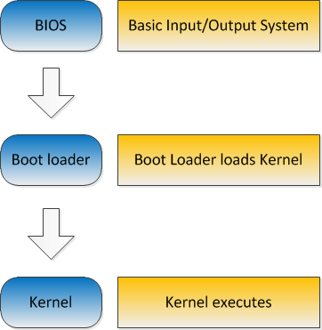
Project 1 – Bootloader
Booting procedure

Slide 4
Project 1 – Bootloader
BIOS
Basic Input/Output System
Firmware used to perform hardware initialization after power-on
Automatically load bootloader in bootblock
Bootblock
Loaded by BIOS
Located in the first sector on hard disk

Slide 5
Project 1 – Bootloader
Bootloader
A small program to enable operating system
Load the kernel
Switch control to the kernel

Slide 6
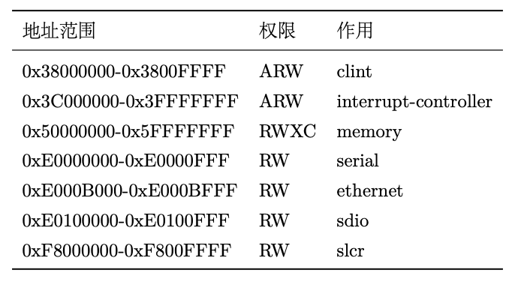
Project 1 – Bootloader
Memory layout
BBL (BIOS)
0x5000 0000 – 0x501F FFFF
Bootloader will be placed at 0x5020 0000 by BIOS
Place you kernel at 0x5020 1000 use your own bootloader
Notes:
请修改为MIPS和RISC-V各自的内存布局，bootloader、kernel的内存位置
BBL/U-Boot类似于BIOS，负责加载bootloader以及提供输入输出和SD卡读写的服务，QEMU上用的是U-Boot，板子上用的是BBL。
RISC-V没有MIPS那种TLB unmap之类的区域划分，这里给的表格是板子上各种设备以及内存的地址。内存的地址详细给出了三个部分的地址。

Slide 7
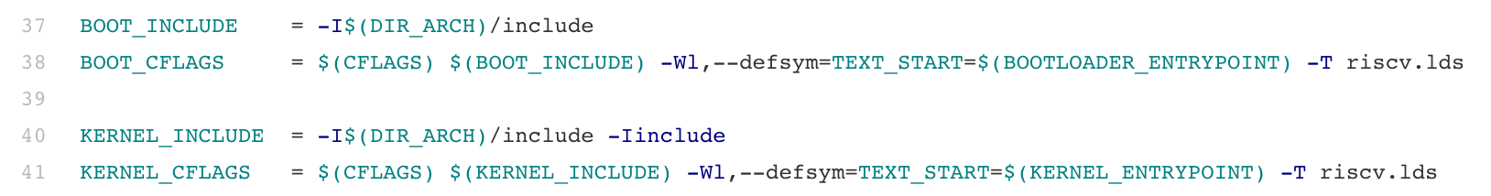
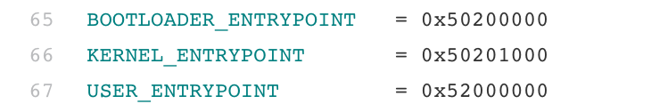
Project 1 – Bootloader
Memory layout
Makefile in start-code defines the location of you kernel in memory
Notes:
MIPS和RISC-V是否用makefile来决定kenrel位置？

Slide 8
Project 1 – Bootloader
Tiny kernel
head.S
Define .entry_function section
Clear bss segment
Prepare runtime for kernel, such as setting stack pointer
Call kernel main function
Notes:
请把MIPS和RISC-V的小内核函数放在这里
RISC-V小内核涉及到head.S和kernel.c两个文件
head.S设置sp指针，清空bss（即设置好c语言的运行环境），之后跳转到kernel.c中的main，进入到C代码部分。

Slide 9
Project 1 – Bootloader
Tiny kernel
main.c
Check bss segment
Initialize jump table for calling lower-level BIOS functions
Print welcome message
Initialize user applications
Wait for input
Echo input
Load and execute user applications
Notes:
请把MIPS和RISC-V的小内核函数放在这里
RISC-V小内核涉及到head.S和kernel.c两个文件
head.S设置sp指针，清空bss（即设置好c语言的运行环境），之后跳转到kernel.c中的main，进入到C代码部分。

Slide 10
Project 1 – Bootloader
Jump table for BIOS functions
BBL provides SBI(Supervisor Binary Interface) to support reading SD card, putting/getting char to/from console
You do not need to modify them, you can read source code for your interests
include/os/bios.h
arch/riscv/bios/common.c
Notes:
请修改或补充用到的BIOS函数
RISC-V通过ecall指令进入M态调用BBL/U-BOOT提供的SBI函数完成相关功能。整个过程类似于系统调用。和MIPS那边直接跳转到某个函数不太一样。

Slide 11
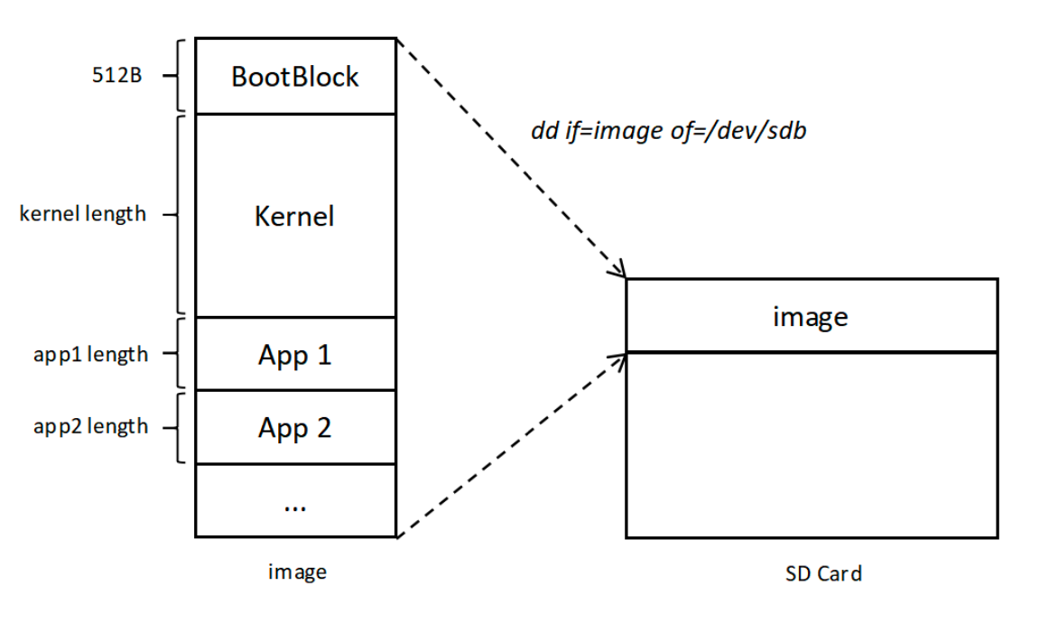
Project 1 – Bootloader
Kernel image
Executable file
bootloader
Kernel
User applications

Slide 12
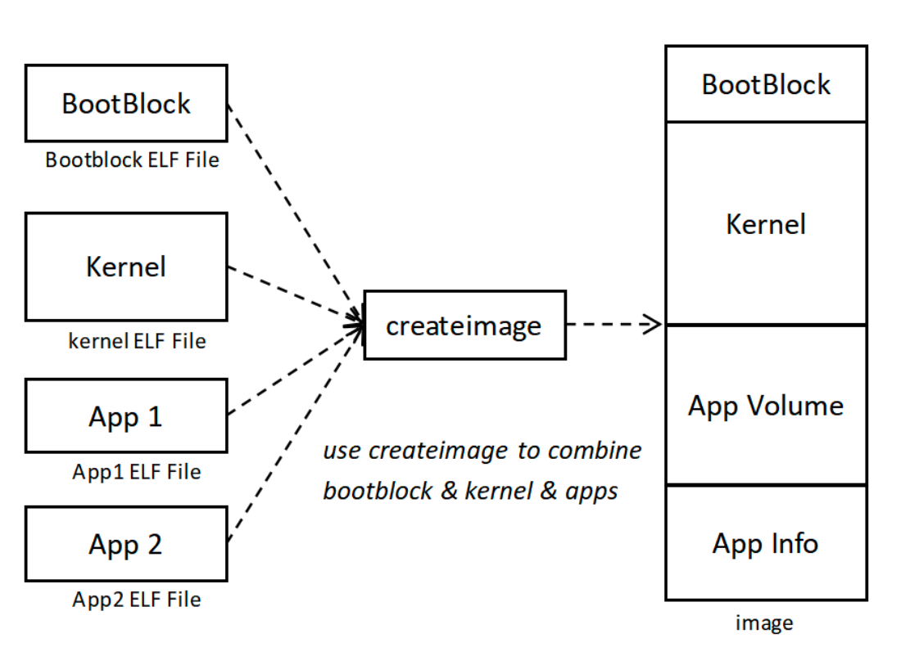
Project 1 – Bootloader
Create image
Use createimage tool to generate the image
Parse ELF files and combine their segments

Slide 13
Project 1 – Bootloader
ELF object file format
Executable and Linking Format (ELF)
Object file
Binary representation of programs
Created by assembler and link editor

Slide 14
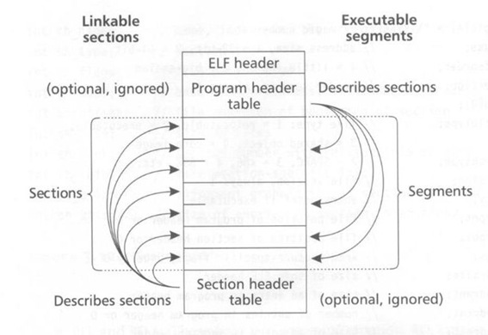
Project 1 – Bootloader
ELF object file format
Executable and Linking Format (ELF)

Slide 15
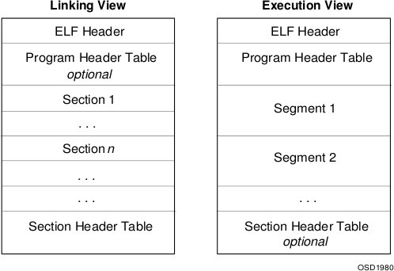
Project 1 – Bootloader
ELF object file format
Executable and Linking Format (ELF)

Slide 16
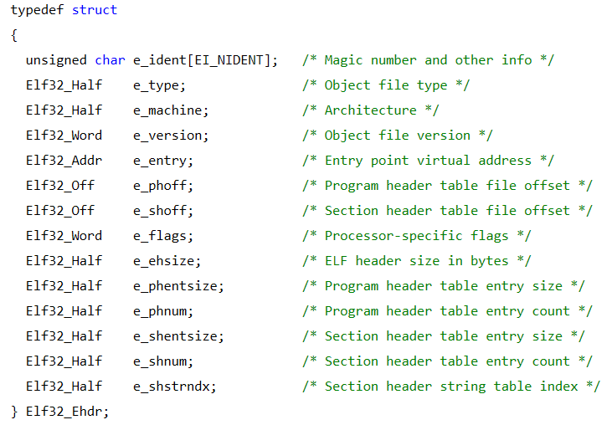
Project 1 – Bootloader
ELF object file format
ELF header

Slide 17
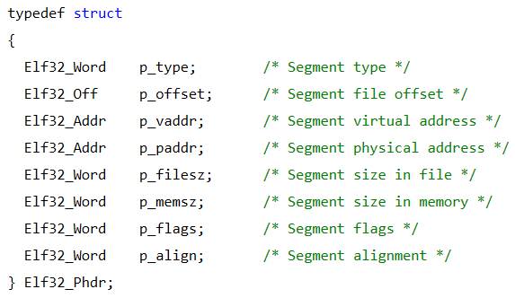
Project 1 – Bootloader
ELF object file format
Program header

Slide 18
Project 1 – Bootloader
App volume
Segments of user applications
You can use fix-sized sectors to store applications with padding
You can store applications in a compacted layout without padding

Slide 19
Project 1 – Bootloader
App Info
A simple index to tell kernel
The sector offset and size of an application in the image
The memory location of the entry point of an application
Application name

Slide 20
Project 1 – Bootloader
App Info
The app info is used by kernel to load an application
You need to write app info into image file, and let bootloader load it into memory when loading kernel

Slide 21
Project 1 – Bootloader
Step by step – Task1
Develop a simple bootloader to only print characters
Help to understand how the bootloader work and how to invoke BIOS functions (using bios_* functions)

Slide 22
Project 1 – Bootloader
Step by step – Task 2
Develop bootblock.S to load kernel
Develop head.S to clear bss, set stack, and jump to kernel main function
Develop main.c to get console input and echo the inputted char
Use the given createimage to generate kernel image

Slide 23
Project 1 – Bootloader
Step by step – Task 3
Develop createimage.c (write_img_info function) to add info into kernel image file, such as kernel size, user application number and location
Kernel, applications occupy the fix-sized sectors
Develop main.c to allow user input task ID for launching applications
Develop loader.c to support load user applications
Develop crt0.S to initialize runtime for application

Slide 24
Project 1 – Bootloader
Step by step – Task 4
Do not use fix-sized sectors to store kernel and applications. Instead, use their actual size when storing them into image file without padding
Use application name to launch an application. You need to design task_info_t structure

Slide 25
Project 1 – Bootloader
Step by step – Task 5
Kernel image compression
Require the kernel image to be saved in a compressed state on the SD card, self decompressed during the bootloader, and able to enter the kernel. （using DEFLATE algorithm）
Notes:
DEFLATE压缩算法不需要自行实现，已经提供好了能够直接调用的 C 库，需要包含头文件tinylibdeflate.h

Slide 26
Project 1 – Bootloader
Requirement for design review
Answer following questions
Explain the code architecture of P1
How does your kernel load an application and make it run?
What is the structure of task_info_t in your design? How do you initialize task_info_t?
Explain the contents and their offset in your designed image file
Any question you want to ask us
Notes:
5，10，25

Slide 27
Project 1 – Bootloader
Requirement for S/A/C-Core
Core type | Task requirements
S-Core | Tasks 1, 2, 3
A-Core | Tasks 1, 2, 3, 4
C-Core | Tasks 1, 2, 3, 4, 5

Slide 28
Tips
Pls. first use QEMU for test. You will get the Pynq board at P1 due
Learn to work on Linux
Watch out the outputs
Read the task handbook carefully
Pay attention to the memory address when you place kernel images

Slide 29
Tips
About asking questions
Think and try to describe your problem clearly
Pls. do not just show us a screenshot
Pls. do google search before you ask questions
Discuss with your classmate

Slide 30
Schdule
P1 design review
Sep. 18
P1 due
Sep. 25

